Slide 1

Hemvati Nandan Bahuguna Garhwal University
School of Engineering and Technology Department of Computer Science and Engineering Session: 2022-23 Project Presentation
On
"Help2gether: Crowdfunding Platform based on Blockchain"
Submitted To: Submitted By: Dr. Prem Nath Sir Aditya kumar singh
Associate Professor CSE (4th Sem)

Slide 2
Index
Introduction Of Crowd funding
WHAT IS BLOCKCHAIN
Objective and scope
Traditional model of Crowd Funding
Problem with existing crowd funding model
Idea of Our Project Crowdfunding Model
Project Overview
Tech Stack Analysis
Webapp Design Presentation
Conclusion
References

Slide 3

Introduction Of Crowd funding
Crowdfunding is a way to raise funds for a specific cause or project by asking a large number of people to donate money, usually in small amounts, and usually during a relatively short period of time, such as a few months.
1. Donation-based crowdfunding
One of the most popular types of fundraising, donation-based crowdfunding is simply asking for a small donation from a large number of people to raise money for something you care about.
2. Reward-based crowdfunding
Reward-based crowdfunding, involves individuals contributing to a business
in exchange for a reward typically a form of the product or service which
the company offers.
3. Equity crowdfunding
An equity crowd funder will invest money in return for shares, or a small stake in your business, project or venture.
This type of crowdfunding could work best for growth-focused companies in areas where there is potential for return.

Slide 4
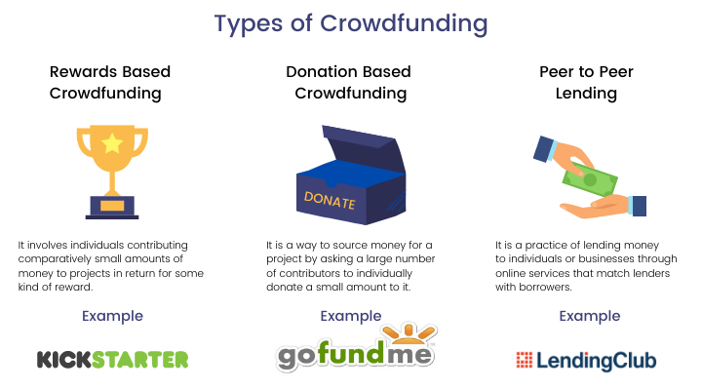
Crowdfunding is one of the most popular ways to raise funds for any project, cause or for helping any individual in need. With the onset of Covid we have seen a rise in Crowdfunding activities across the globe which includes small campaigns to help people get oxygen and medical help to large funds such as PM Cares.

Slide 5
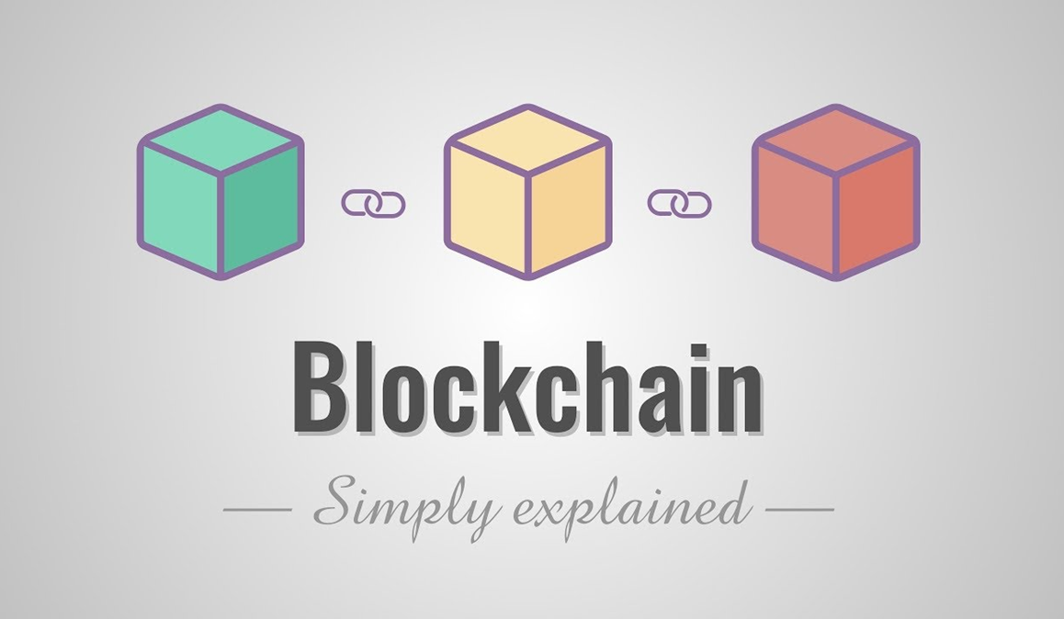
WHAT IS BLOCKCHAIN
The blockchain technology was described in 1991 by the research scientist Stuart Haber and W. Scott Stornetta.
Blockchain is a distributed immutable ledger which is completely transparent

Slide 6
WHAT IS BLOCKCHAIN
In the simplest terms, Blockchain can be described as a data structure that holds transactional records and while ensuring security, transparency, and decentralization. You can also think of it as a chain or records stored in the forms of blocks which are controlled by no single authority. A blockchain is a distributed ledger that is completely open to any and everyone on the network. Once an information is stored on a blockchain, it is extremely difficult to change or alter it.
The blockchain technology was described in 1991 by the research scientist Stuart Haber and W. Scott Stornetta.
Blockchain is a distributed immutable ledger which is completely transparent

Slide 7
Objective:-
Crowdfunding over the years has helped people but has also seen heavy frauds in the name of Crowdfunding. With Help2gether we want to bring transparency to the process of crowdfunding and build trust among people to contribute to all the causes.
Scope of This project:-
With Help2gether I aim to make the crowdfunding process transparent, anti-fraud and secure.

Slide 8

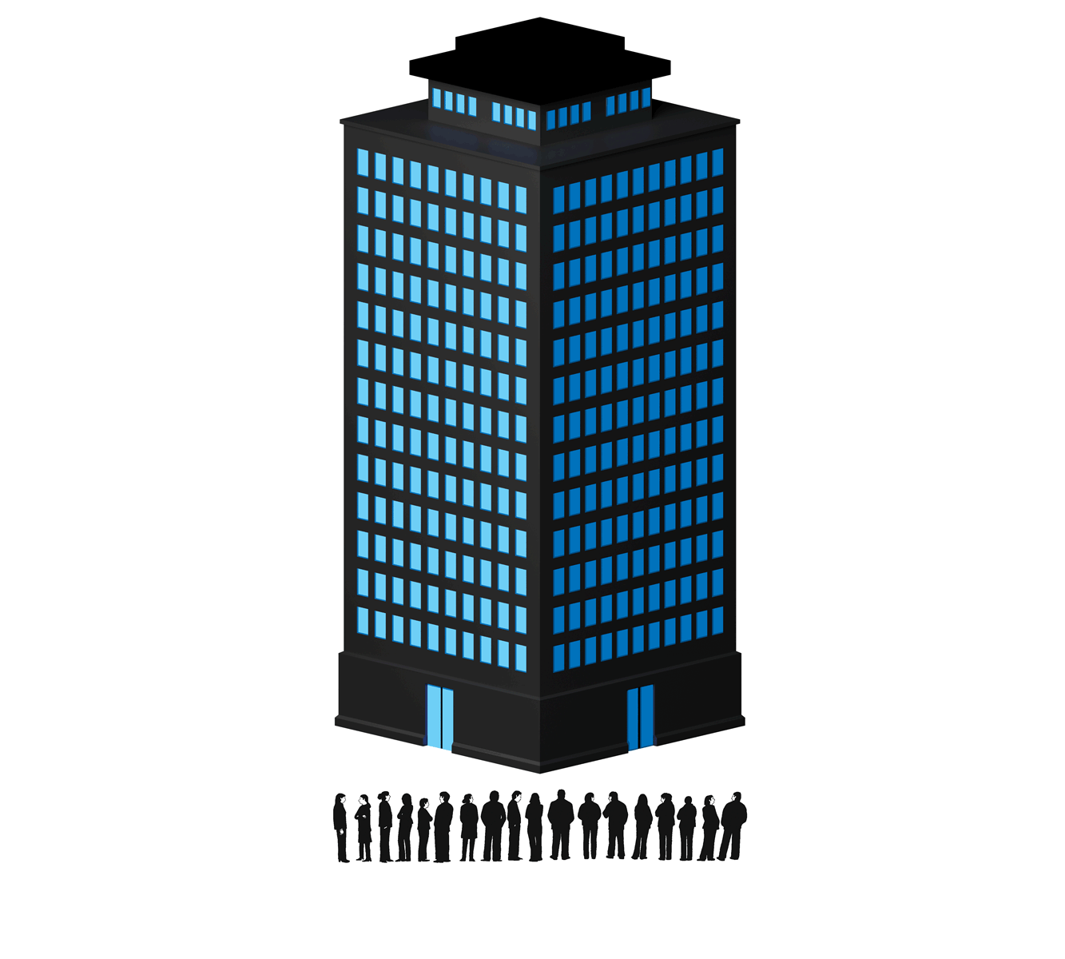

Traditional model of Crowd Funding
Charity
Project
Business

Slide 9
Problem with existing crowd funding software and model
In normal Crowdfunding as there is no security ensured for contribution amount.
Crowdfunding Platform Face The High Risks Of Fraud
Intellectual Property Isn't Protected On Crowdfunding Platform
Transparency & Anti-Fraud
Country boundary

Slide 10
Security:-so as you know that most of the crowdfunding platform face lack of security so by which the amount given by donator are hacked or unsecure so these problems can solve through my project “Help2gether” As the funds become larger, they need to be heavily secure Blockchain — which has never been compromised yet — can provide that level of security.
Transparency and Anti-Fraud :-We have seen, and continue to see a lot of crowdfunding scams happening around. There is no way to see where the funds are being used. We wanted to make the entire flow of funds transparent at every stage, so that there is no possibility of the money being misused.
Global contribution With some of the platforms being country specific, it becomes hard for people from other countries to contribute to various campaigns. Using blockchain anyone in the world can contribute to the campaign. Transactions are quick and convenient.
Intellectual Property Isn't Protected on Crowdfunding Platforms:- Crowdfunding apps don't protect intellectual property at a necessary level. It's possible that a bigger company notices an idea of a small startup and, using its own resources, can implement it faster and even in better quality. It puts creators in a rush, forcing them to either spend more money to patent their idea or to be the first one who brings it to life.
Crowdfunding Platform Face the High Risks of Fraud

Slide 11

Our Solution
Any web based application is a centralized application which means that anything we do on the platform is managed by a server which is owned by a single company.
I propose a Decentralized Application powered by Ethereum Blockchain, where all the information about campaigns, contributions, withdrawal requests and funds are kept on a Blockchain Network, visible to all and decentralized. This means the funds and transactions are visible to and stored at every node on the blockchain, and prevents the data from being stored in a centralized server, single location.
Hence not letting the money get into the hands of anyone and eliminating every possibility of it getting misused — an elegant and logical solution to the problem in hand.

Slide 12


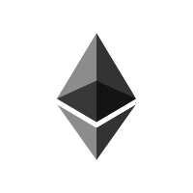

Idea of Our Project Crowdfunding Model
Target
Deadline
Minimum Contribution
Target​
Deadline​

Slide 13

Following are the proposed features

Slide 14
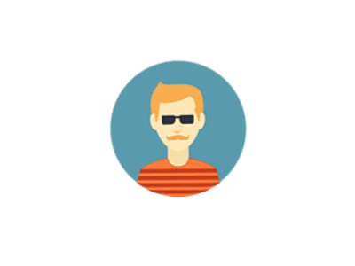
Project Overview
Create Campaign
Donate To campaign

Slide 15
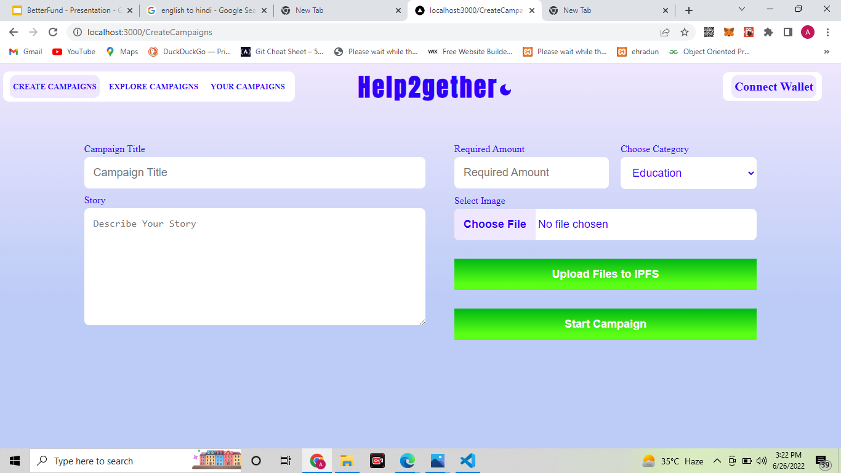
Feature No:1 (Create Campaign)
Just like Crowdfunding in the real world as well as on other crowdfunding platforms, anyone can create a campaign in a few minutes. The campaign information will be managed by the Ethereum-based smart contract and thus cannot be tampered with.

Slide 16
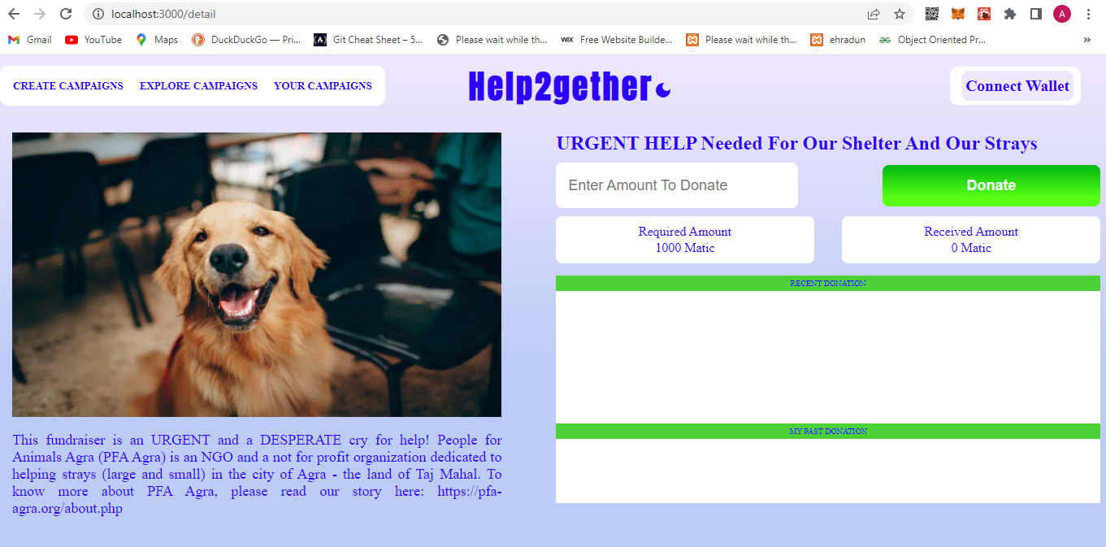
Feature No:2 (Donate To campaign)
Once a campaign has been created, users can share the campaign and anybody can contribute to the campaign. The funds will go to the address of the campaign and not to the creator of the campaign, thus making the process more efficient and anti-fraudulent.

Slide 17
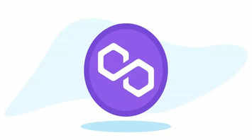
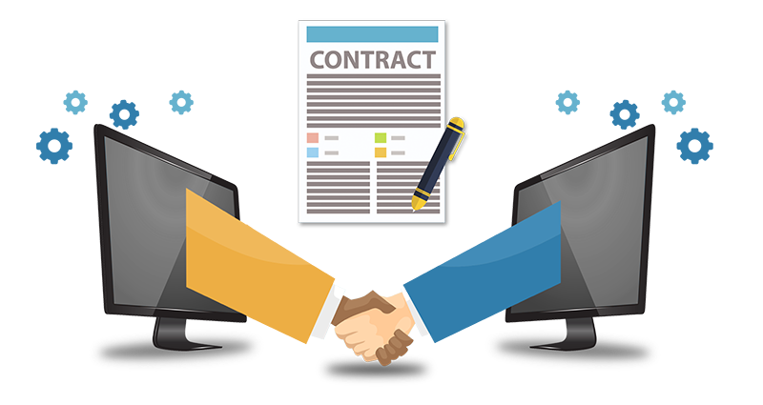
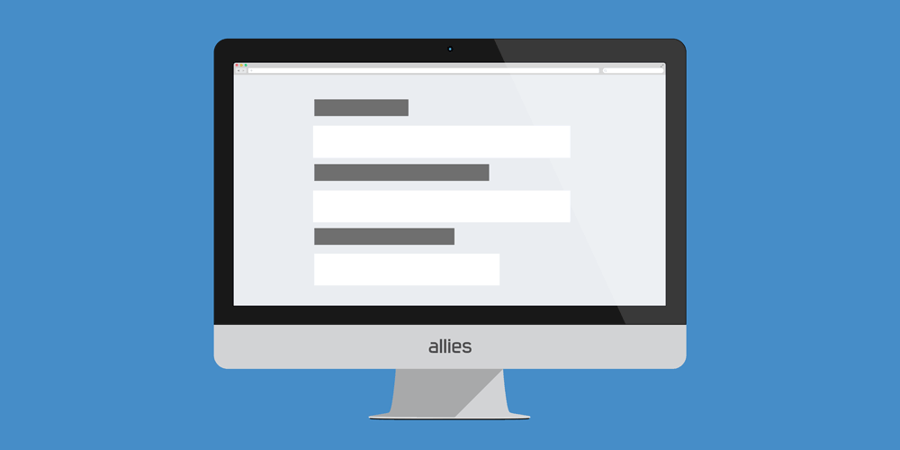

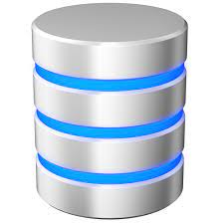
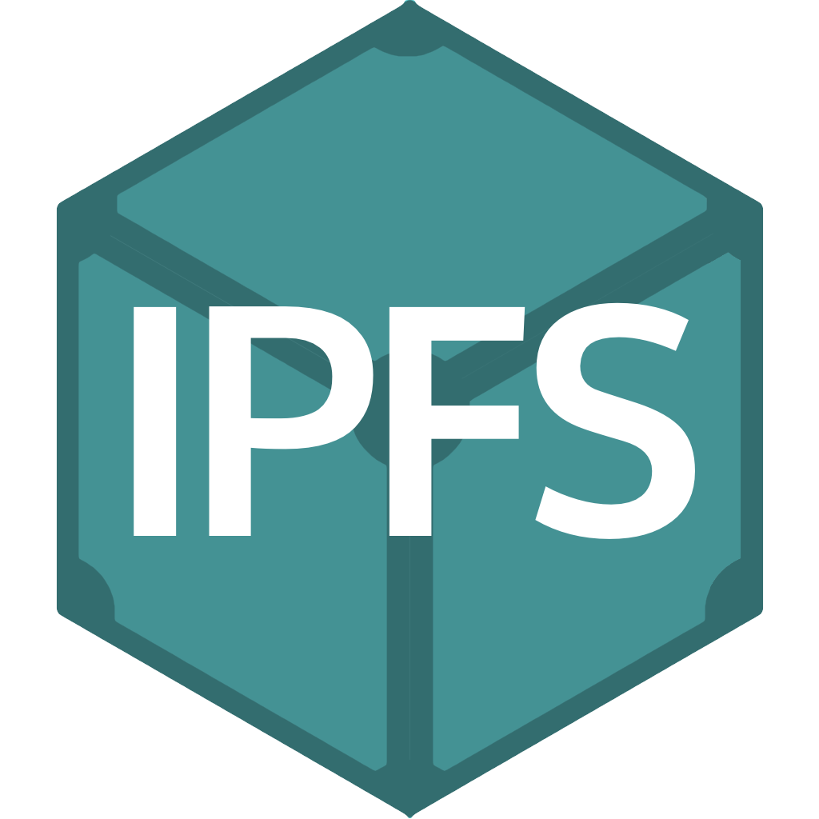
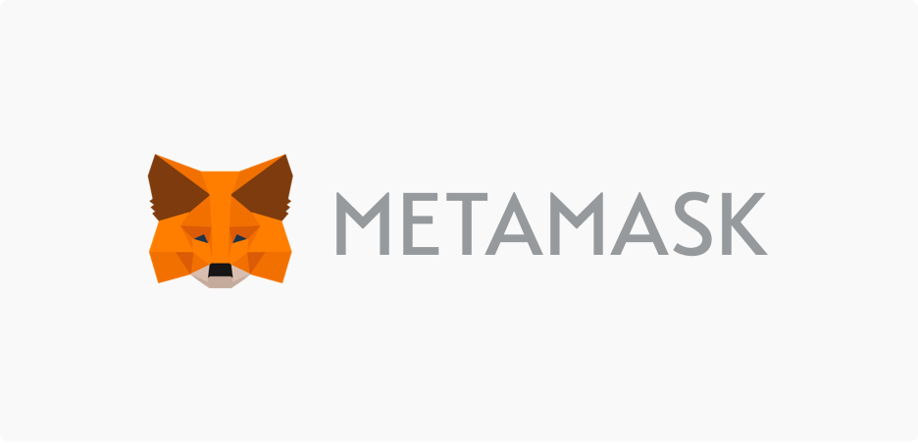
Start a Campaign
Deploy
Solidity Smart
Contract
Polygon (Mumbai)
Form
fill form
Frontend
Link
Database

Slide 18
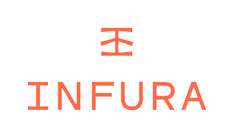

Donate To a campaign
Deployed Campaign
Polygon (Mumbai)​
Donate
Deployed Campaign​

Slide 19

Tech Stack Analysis
In order to achieve the solution we have chosen a tech stack that is:
Optimized For speed
Secure
Efficient

Slide 20
Technology And Software:-
The Technologies that have been used are :
Vs Code
Visual Studio Code is a lightweight but powerful source code editor which runs on your desktop and is available for Windows, macOS and Linux. It comes with built-in support for JavaScript, TypeScript and Node.js and has a rich ecosystem of extensions for other languages and runtimes (such as C++, C#, Java, Python, PHP, Go, .NET).
Remix IDE
Remix Ide is used for the entire journey of smart contract development by users at every knowledge level. It requires no setup, fosters a fast development cycle and has a rich set of plugins with intuitive GUIs. The IDE comes in 2 flavors (web app or desktop app) and as a VS Code extension.

Slide 21
Tools And Frameworks
Solidity
Solidity is a contract-oriented, high-level programming language for implementing smart contracts. Solidity is highly influenced by C++, Python and JavaScript and has been designed to target the Ethereum Virtual Machine (EVM).
Node.js
Node.js is an open source server environment.
Node.js allows you to run JavaScript on the server
Node.js is free
Node.js runs on various platforms (Windows, Linux, Unix, Mac OS X, etc.)

Slide 22
Tools And Frameworks
Next.js
Next.js is a lightweight framework for React applications. In web development, it’s used to build fast web apps thanks to its static site and server-side rendering.
Polygon
Polygon is a cryptocurrency, with the symbol MATIC, and also a technology platform that enables blockchain networks to connect and scale.
Polygon is a “layer two” or “sidechain” scaling solution that runs alongside the Ethereum blockchain — allowing for speedy transactions and low fees.

Slide 23
Tools And Frameworks
Hardhat
Hardhat is an environment developers use to test, compile, deploy and debug dApps based on the Ethereum blockchain. As such, it helps coders and developers to manage many of the tasks that are inherent to developing dApps and smart contracts
Styled-components
Styled-components is a popular library that is used to style React applications. It allows you to build custom components by writing actual CSS in your JavaScript.

Slide 24

Webapp Design Presentation I will present the six major features of Webapp: change theme of website Connect Wallet
Creating a Campaign
Contributing to a Campaign
Your Campaign Explore Campaign

Slide 25
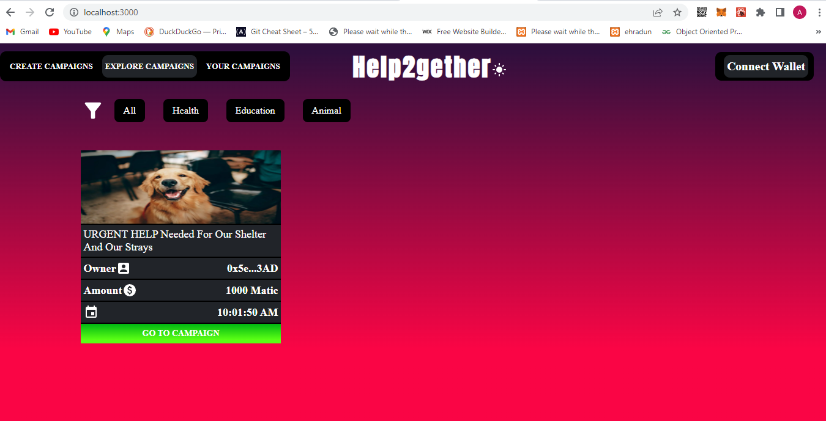

Slide 26
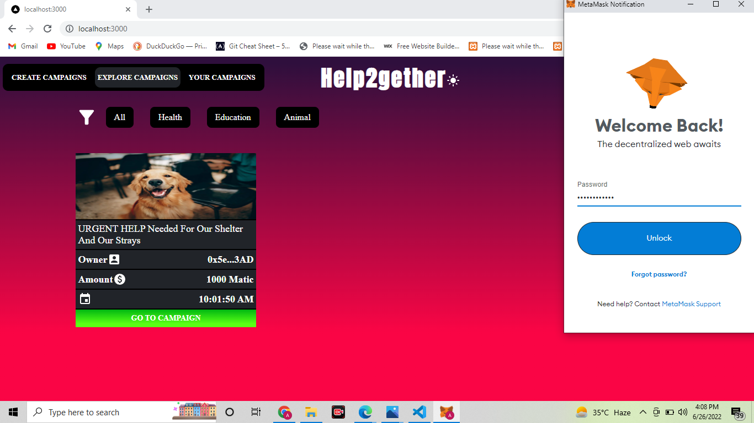

Slide 27
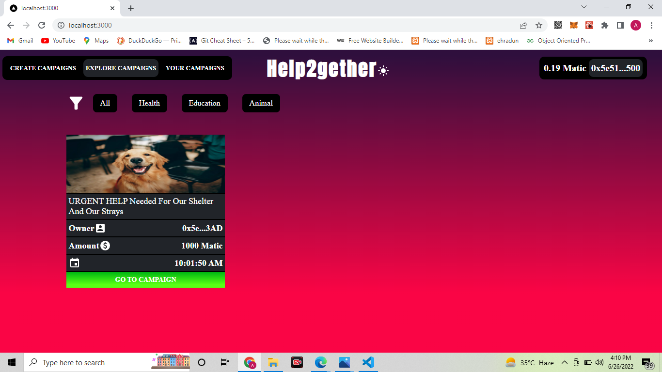
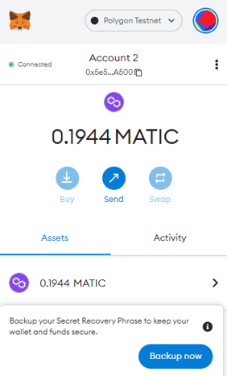

Slide 29
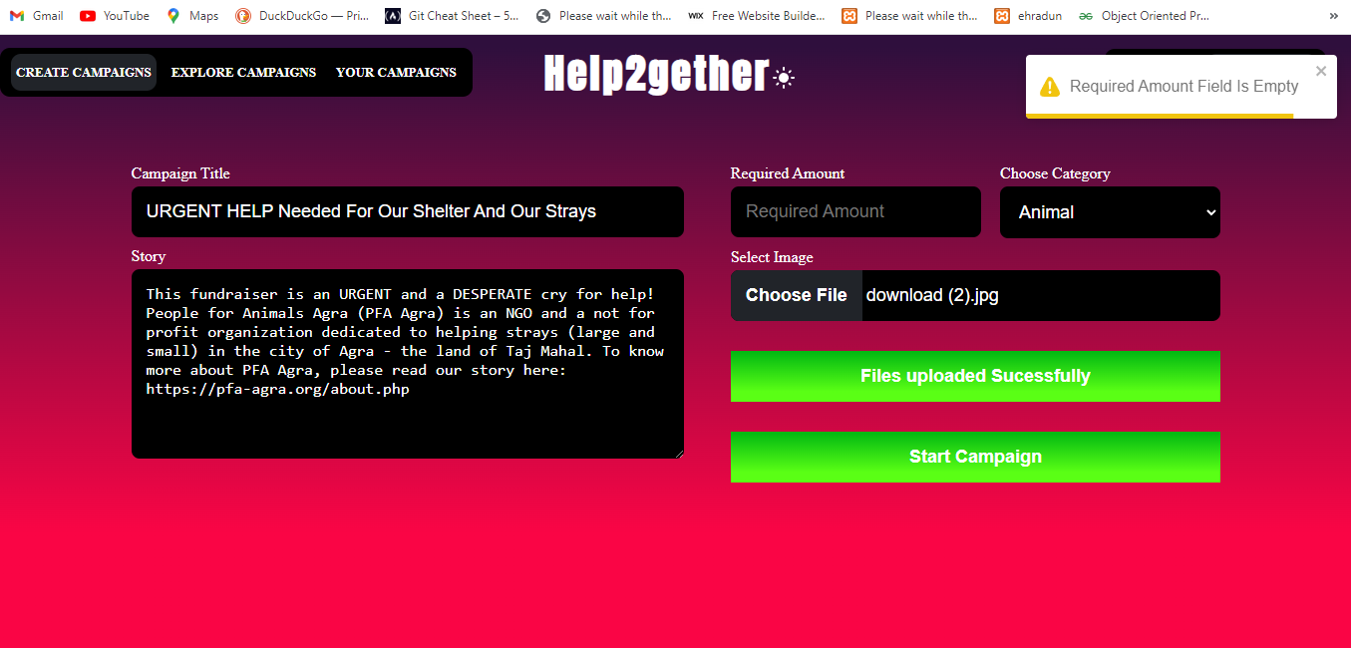

Slide 30
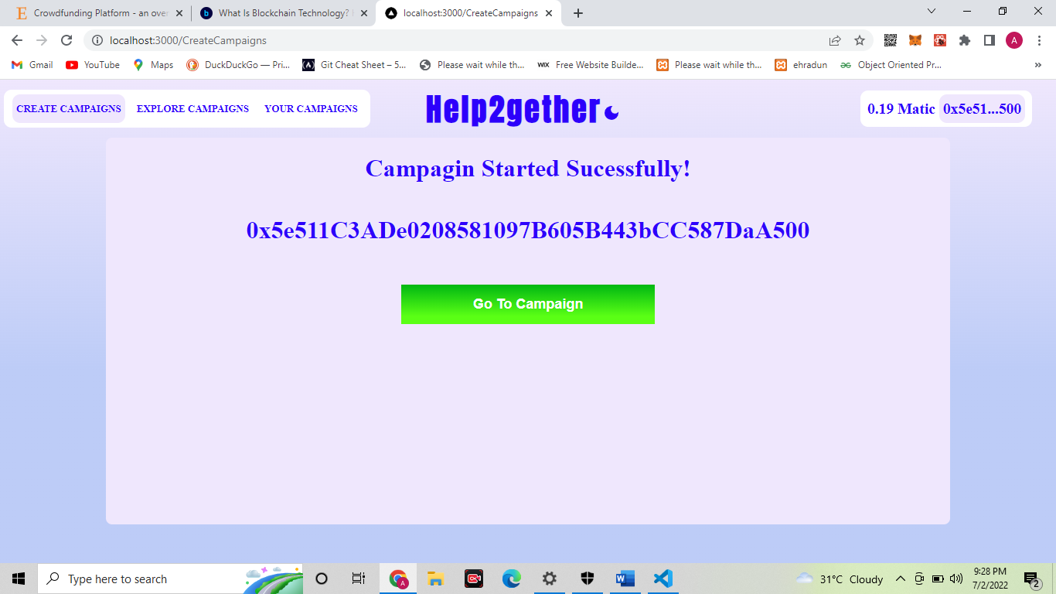

Slide 31
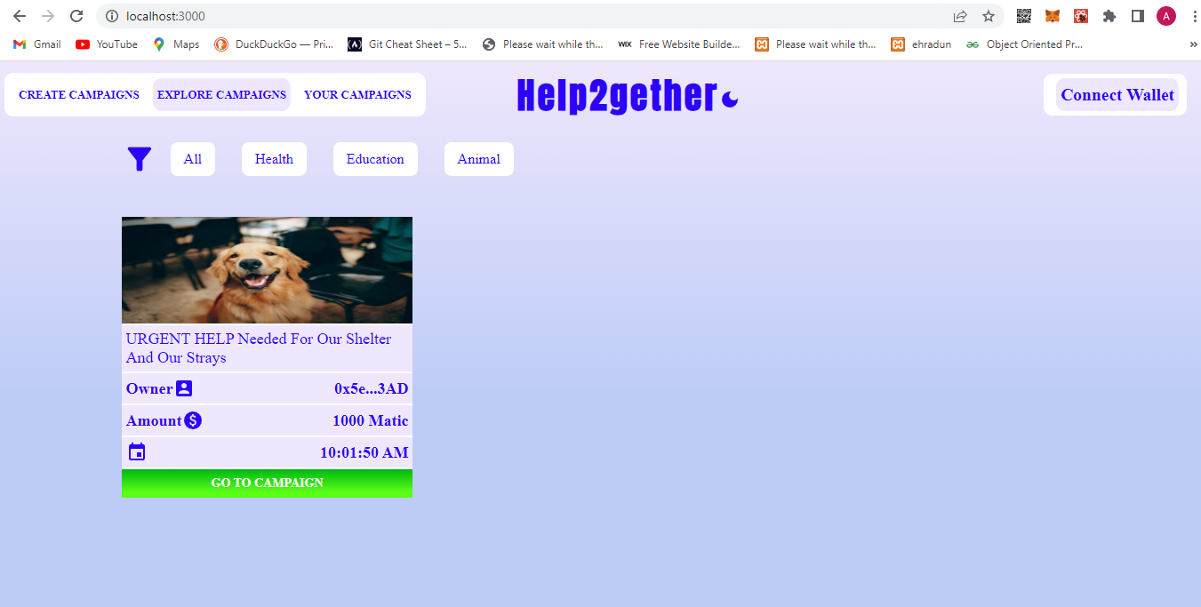

Slide 33
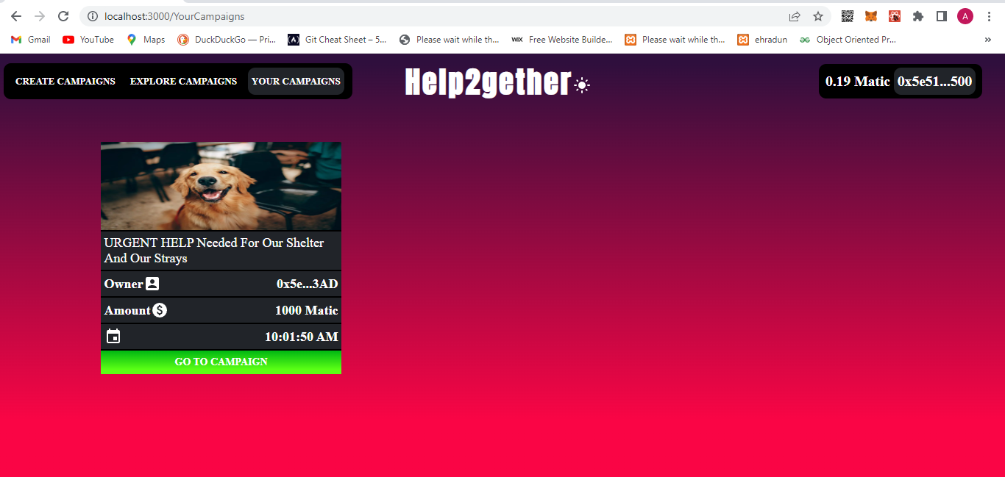

Slide 34
How to use this WebApp
1. Connect Wallet :In order to perform any transactions, be it creation of a campaign or contributing to one, a user first needs to connect an Ethereum wallet to the site. I have made use of a browser extension called Meta mask to connect the wallet, which can be used to authorize transactions for cryptocurrency. ​
2. Creating a Campaign: Once a wallet has been connected, anyone can create a crowdfunding campaign. The process is highly intuitive and self-explanatory, and the user only has to supply the data as asked in the forms​
3. Contributing to a Campaign : Any user whose wallet has been connected to the app can contribute to a campaign. The process is simple and detailed in the flow below. The user only needs to select the campaign, enter the amount he wishes to contribute, and then authorize the transaction (in this case, with the Meta mask extension). ​

Slide 35
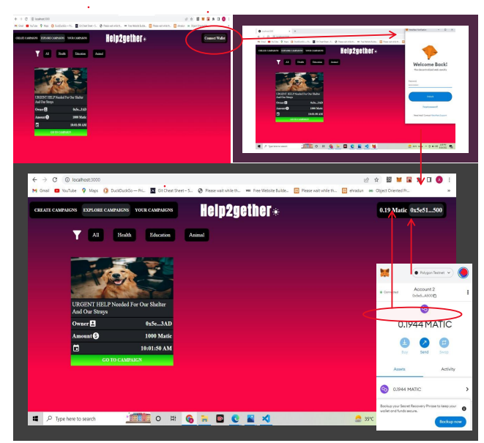

Slide 36
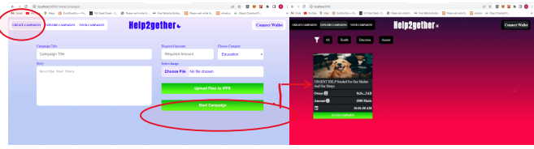
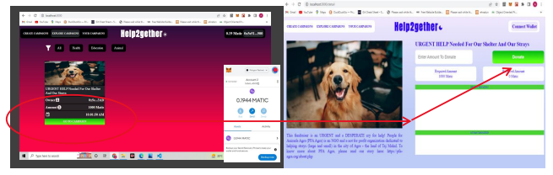

Slide 37
Advantages of Help2gether
security
Greater transparency
efficiency and speed
Automation

Slide 38
Conclusion
Now my Project "Help2gether: Crowdfunding Platform based on Blockchain" is complete and fully functional.
Conventional crowdfunding methods have long suffered from lack of transparency and fraud. It is an avoidable problem, and we believe that we have implemented a solid solution that can do away with these long-standing problems.
The aim to have a transparent, anti-fraudulent, decentralized platform has been achieved to a great extent. This project has covered the weak points of general crowdfunding platforms to provide transparency to the process of crowdfunding and build trust among people, so that they may contribute their wealth to good causes without fear of fraud.

Slide 39
References
https://www.blockchain.com/
https://dev.to/ruppysuppy/how-i-created-a-crowdfunding-platform-with-web3-micro-frontends-3pb2
https://scholarworks.calstate.edu/downloads/cf95jb83g
1) Simply Explained
2) Dapp University
https://www.youtube.com/watch?v=SSo_EIwHSd4
Youtube channel:-
https://www.youtube.com/c/DappUniversity

Slide 40


